Slide 1

Flowering time Candidate Genes

Slide 2
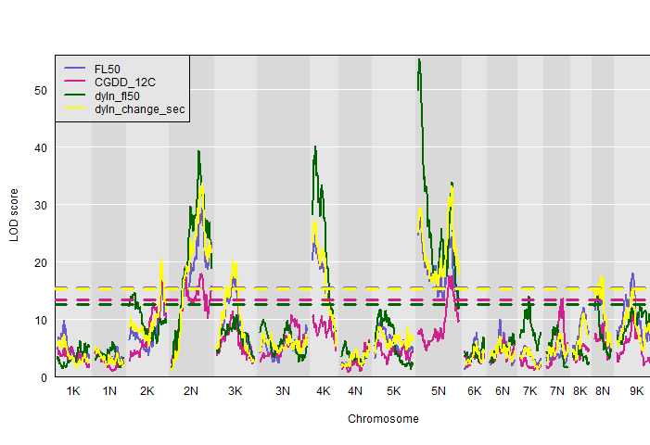
2019 flowering time data – two mapping pops
Fourway cross: Major QTL on Chr05N for flowering as a function of daylength and cumulative growing degree days
Diversity Panel: GWAS on same (50% flowering) traits in individuals from the same genetic subpops (Gulf and Midwest).
18 GWAS total

Slide 3
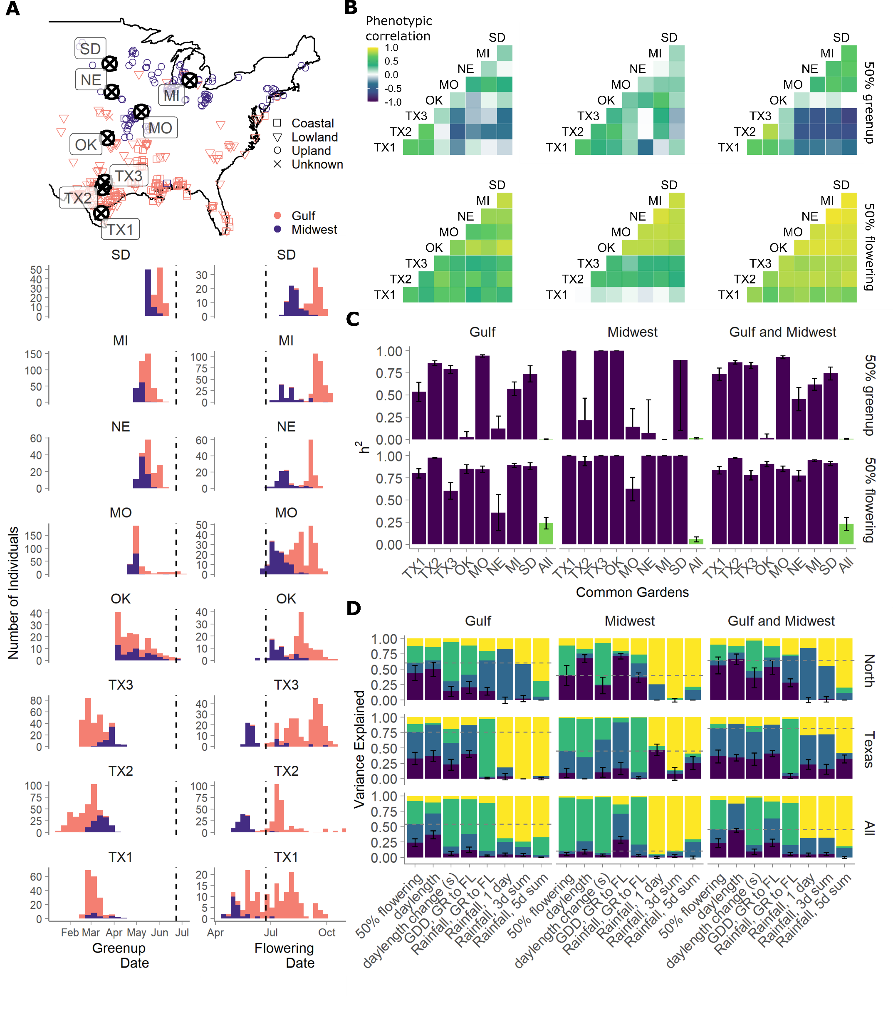
18 GWAS total
On genetic BLUPs (see panel D)
phenotype ~ random(site) + random(kinship) + random(site*kinship)
For two traits
Daylength & cumulative GDD
For three population sets
Gulf, Midwest, and both
In three environment sets
Texas sites, North sites, All sites

Slide 4
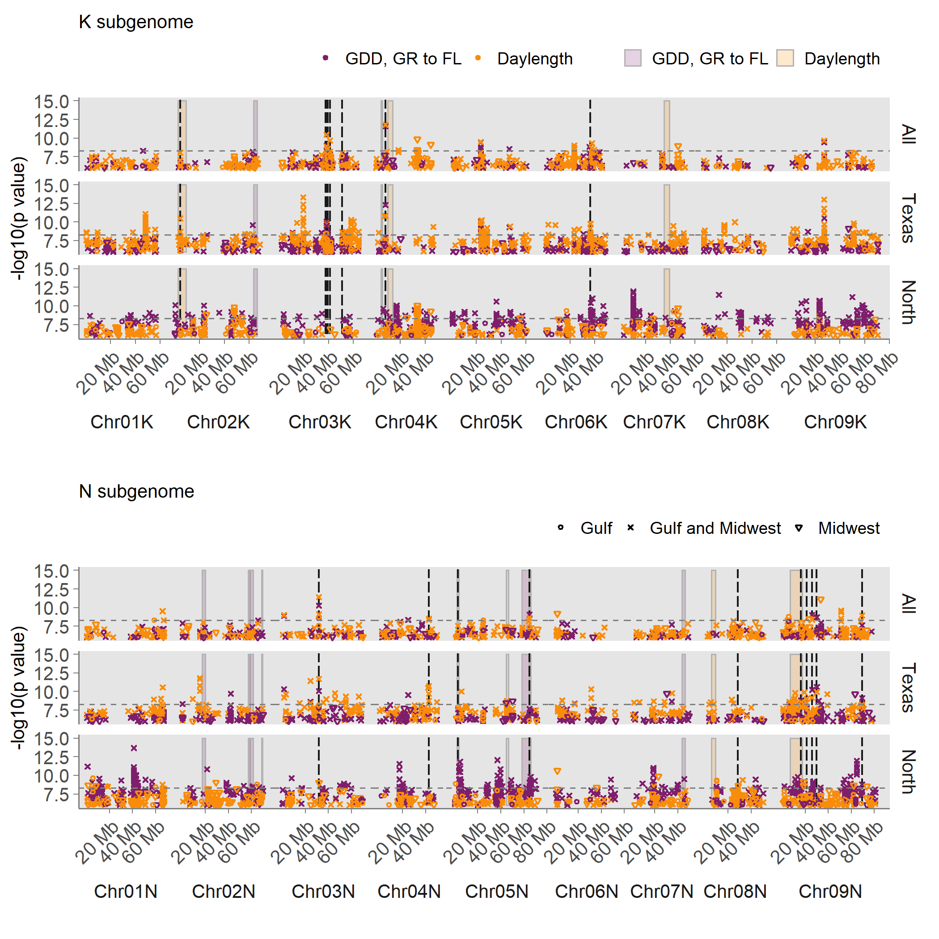
Two overlaps on Chr05N between the fourway QTL (bars) and several GWAS (points)

Slide 5
Candidate genes on Chr05N
Candidate genes on Chr05N may underlie consistent genetic effects detectable in multiple mapping populations across the species’ natural range.
Chr05N 64.84 Mb Pavir.5NG109745 DOF
Chr05N at 64.86 Mb, which was significant across subpopulations at all three sets of gardens
Top SNPs are 4110 bp from this gene.
Dof-type zinc finger DNA-binding family protein (AT2G28510; LOC_Os01g64590)

Slide 6
Chr05N 64.84 Mb Pavir.5NG109745 DOF
n_SNPs <int> | n_Mb <int> | sites <chr> | subpop <chr> | phe <chr> | CHR <chr> | POS_Mb <dbl>
1 | 8 | eight_sites | Gulf | dyln_fl50 | Chr05N | 64.86
1 | 8 | eight_sites | Gulf_and_Midwest | cgdd_12c_gr2fl | Chr05N | 64.86
1 | 8 | eight_sites | Gulf_and_Midwest | dyln_fl50 | Chr05N | 64.86
1 | 8 | north_sites | Gulf_and_Midwest | cgdd_12c_gr2fl | Chr05N | 64.86
1 | 8 | north_sites | Gulf_and_Midwest | dyln_fl50 | Chr05N | 64.86
1 | 8 | tx_sites | Gulf | crain_gr2fl | Chr05N | 64.86
1 | 8 | tx_sites | Gulf | dyln_fl50 | Chr05N | 64.86
1 | 8 | tx_sites | Gulf_and_Midwest | cgdd_12c_gr2fl | Chr05N | 64.86

Slide 7
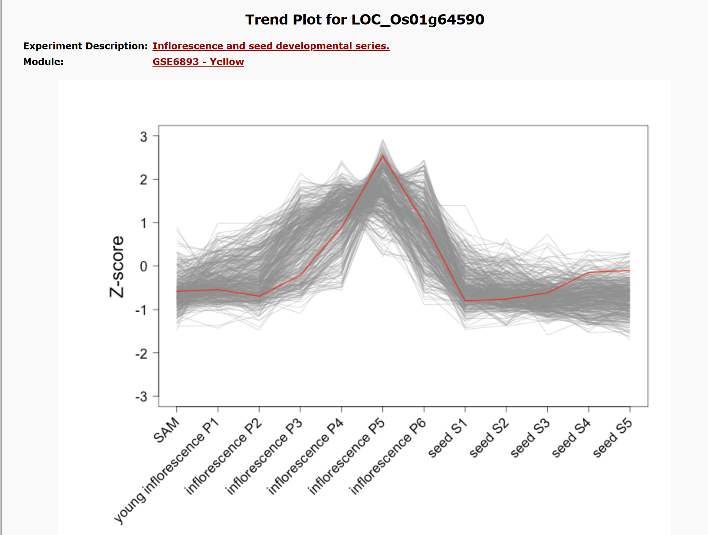
In Rice
LOC_Os01g64590

Slide 8
Gene expression in rice
Library Name | Library Description | Rice Genotype | FPKM
OSN_AA | Leaves-20 days | Nipponbare | 0
OSN_AB | Post-emergence inflorescence | Nipponbare | 4.97725
OSN_AC | Pre-emergence inflorescence | Nipponbare | 1.74124
OSN_AD | Anther | Nipponbare | 0.498917
OSN_AE | Pistil | Nipponbare | 5.94767
OSN_AF | Seed-5 DAP | Nipponbare | 0.30654
OSN_AG | Embryo- 25 DAP | Nipponbare | 0.751609
OSN_AH | Endosperm- 25 DAP | Nipponbare | 0
OSN_AK | Seed- 10 DAP | Nipponbare | 0
OSN_BH | Endosperm- 25 DAP (replicate) | Nipponbare | 0
OSN_CA | Leaves- 20 days (replicate) | Nipponbare | 0.123654
SRR042529 | Shoots | Nipponbare | 0

Slide 9
Other genes within 25kb either side of this SNP?
LD decays 50% on average in the switchgrass genome within ~20kb (John’s plotted in the genome paper).
Thus genes more than 20kb away from the SNP are unlikely to be in strong linkage with this SNP.
Gene | Distance from SNP | A. thaliana homolog | A. thaliana gene expression | Rice homolog | Rice gene expression (parentheses indicate an experiment unique to that gene)
Pavir.5NG109746 | (18.7kb) | AT1G49200 RING/U-box | High in hypocotyl, silique with and without seeds | LOC_Os01g64620 | High in post-emergence inflorescence, seed 5 DAP; (radicle, root, stem)
Pavir.5NG109743 | (22.5kb) | AT2G22590 UDP-glycosyl transferase | high in mature flower petals | LOC_Os01g64540 | High in 20-day old leaves
Pavir.5NG109744 | (17.9kb) | AT2G35930 (PUB23) plant U-box | High in senescent leaf petiole; (neg. reg. of drought tolerance) | LOC_Os01g64570 | High in anther
Pavir.5NG109745 | (4.1kb) | AT2G28510 Dof-type zinc finger DNA binding Dof2.1 | high in the carpel of the young flower & in seeds during germination day 1; (promotes leaf senesc.) | LOC_Os01g64590 OsDof6 | High in post-emergence inflorescence and pistil; (increases during inflorescence development)

Slide 10
Chr05N 2.79Mb 175bp from gene Pavir.5NG031900
n_SNPs <int> | n_Mb <int> | sites <chr> | subpop <chr> | phe <chr> | CHR <chr> | POS_Mb <dbl>
1 | 6 | tx_sites | Gulf_and_Midwest | cgdd_12c_gr2fl | Chr05N | 2.79
1 | 6 | tx_sites | Gulf_and_Midwest | dyln_fl50 | Chr05N | 2.79
1 | 6 | eight_sites | Gulf | dyln_fl50 | Chr05N | 2.79
1 | 6 | eight_sites | Gulf_and_Midwest | cgdd_12c_gr2fl | Chr05N | 2.79
1 | 6 | eight_sites | Gulf_and_Midwest | dyln_fl50 | Chr05N | 2.79
1 | 6 | tx_sites | Gulf | dyln_fl50 | Chr05N | 2.79

Slide 11
Chr05N 2.79Mb
Gene ID <chr> | distance from SNP <int> | Arabidopsis thaliana homolog <chr> | A. thaliana gene expression | Rice homolog <chr> | Rice gene expression
Pavir.5NG031800 | 1247 | AT2G36320 | Zinc finger family protein; ~constitutive | LOC_Os01g56040
Pavir.5NG031900 | 175 | AT3G14920 | High in ovules, stamens, carpels, mature flower, seeds at 1st flower excision | LOC_Os01g11010 | High in pre-emergence inflorescence, increases during flowering,
Pavir.5NG032000 | 3653 | AT3G14920 | “ | LOC_Os01g10960 | High in pre-emergence inflorescence, pistil, shoots
Pavir.5NG032100 | 16148 | AT3G14920 | “ | LOC_Os01g10950 | High in pre-emergence inflorescence, pistil, shoots
Pavir.5NG032200 | 20385 | AT3G14920 | “ | LOC_Os01g10930 | High in seed 5 DAP
Pavir.5NG032300 | 24940 | AT5G45840 | MALE DISCOVERER1, MDIS1, male receptor of the pollen tube chemo-attractant LURE1 | LOC_Os01g10900 | High in anther, panicle 5, stamen
Pavir.5NG031500 | 20039 | AT1G16900 | High in axis of inflorescence, style, carpel | LOC_Os01g11070 | High in pre-emergence inflorescence, pistil, fairly high in embryo 25 DAP, leaves
Pavir.5NG031600 | 9643 | AT1G29170 | WAVE2, high in axis of inflorescence, style, carpel, involved in plant cell morphogenesis | LOC_Os01g11040 | High in pre-emergence inflorescence
Pavir.5NG031700 | 8973 | NA |  | NA

Slide 12
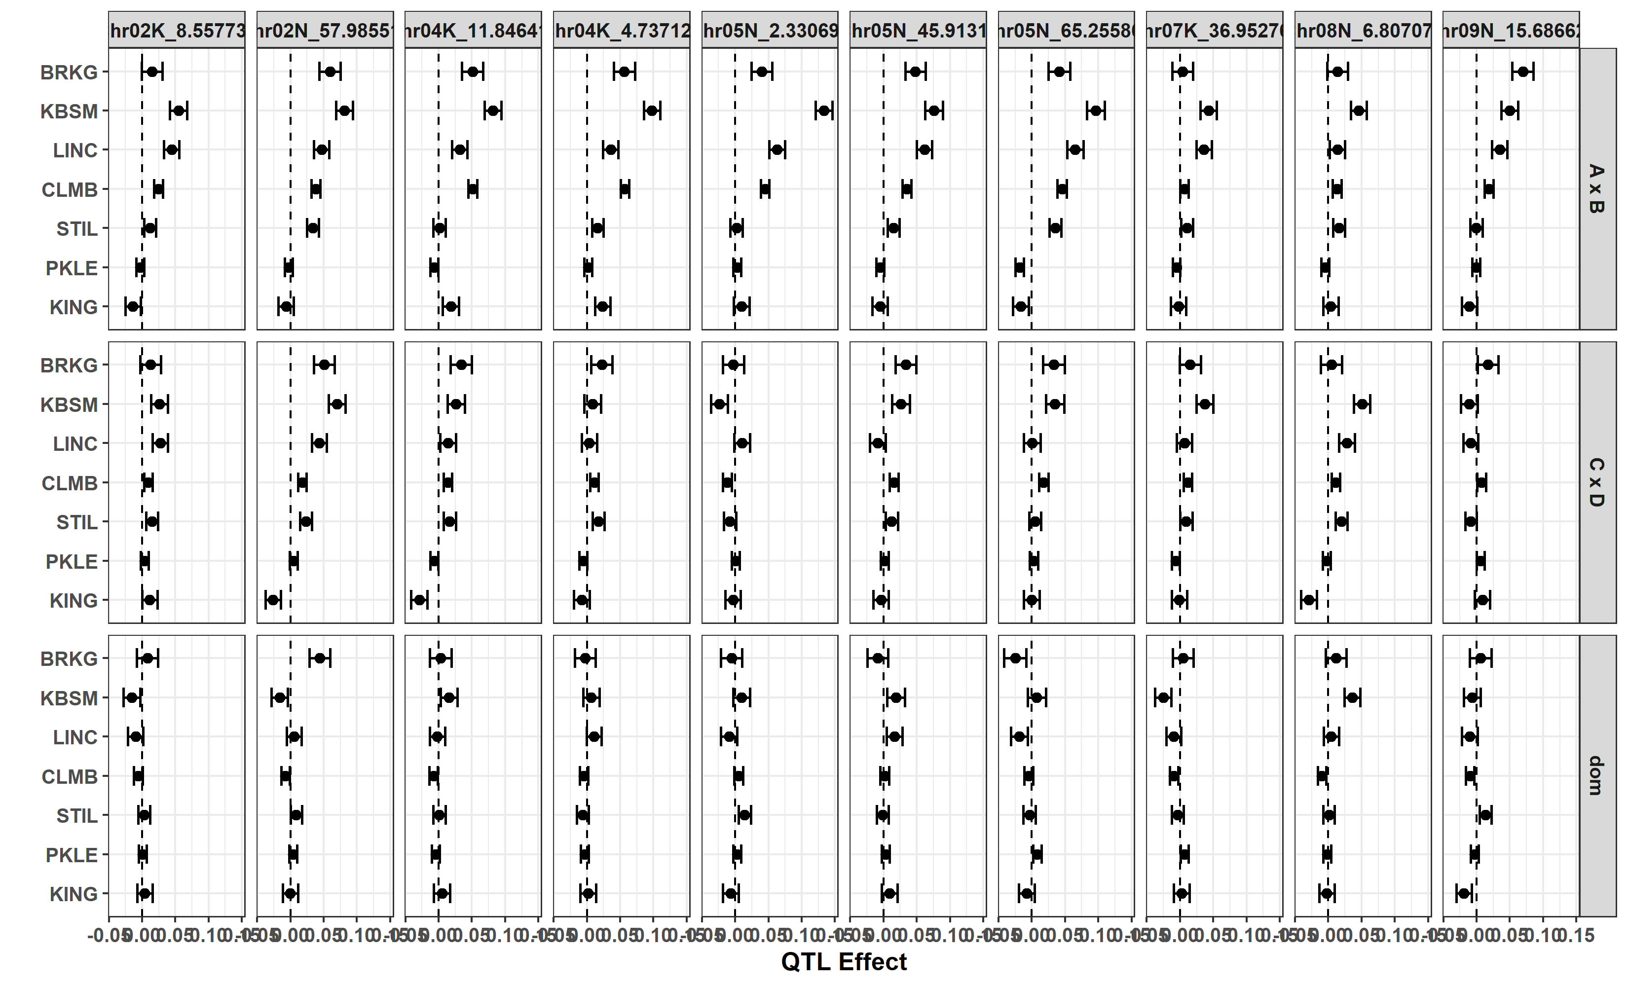
QTL allelic effects for daylength at flowering

Slide 13
Known flowering time candidate genes
PRR5 Pavir.8NG050900
FT Pavir. 5KG044000
PRR7 Pavir. 2NG126000
(Paul’s 2017 FT GWAS; Taylor FIPS ‘GWAS’ – but both used previous version of annotation, and I don’t currently have a way to compare these)

